Slide 1
Application # 1:
Companies providing information about their services:
E.g. Schwab, Inc.

Slide 2


Slide 3
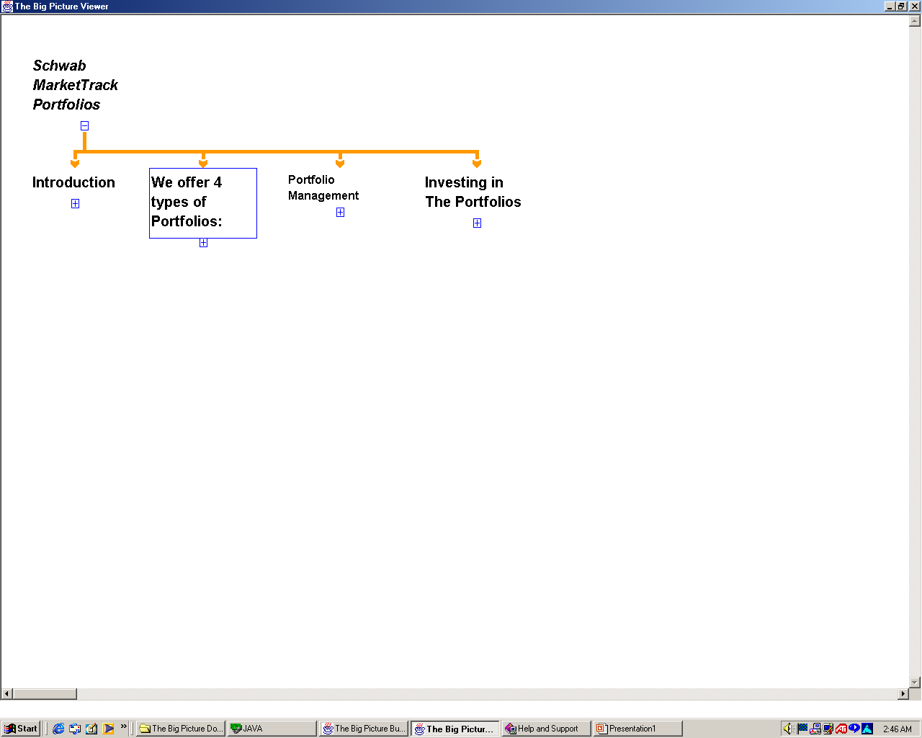

Slide 4
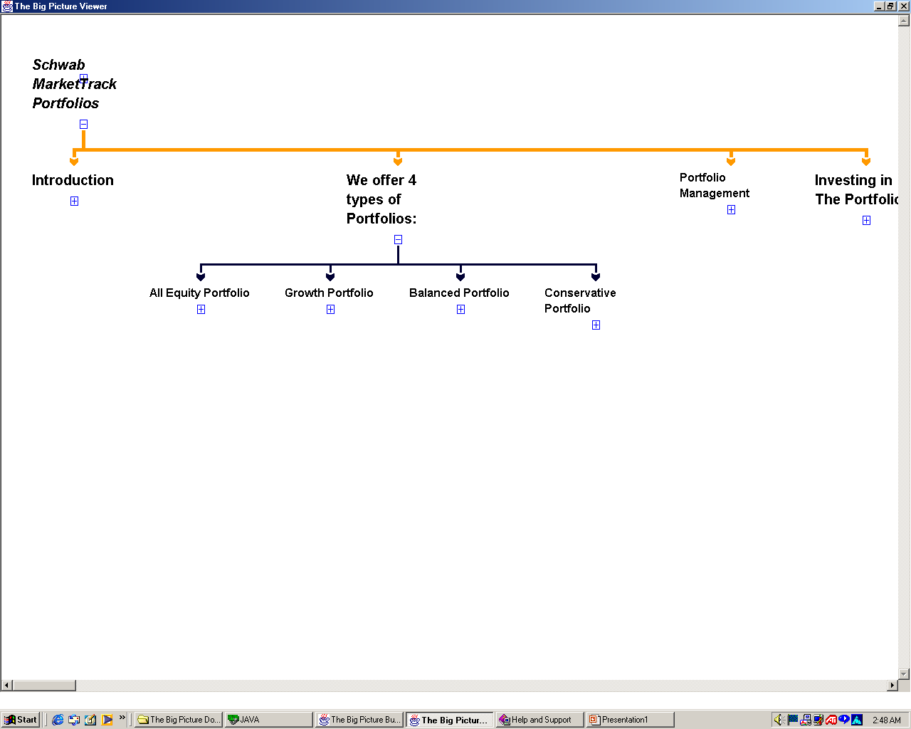

Slide 5
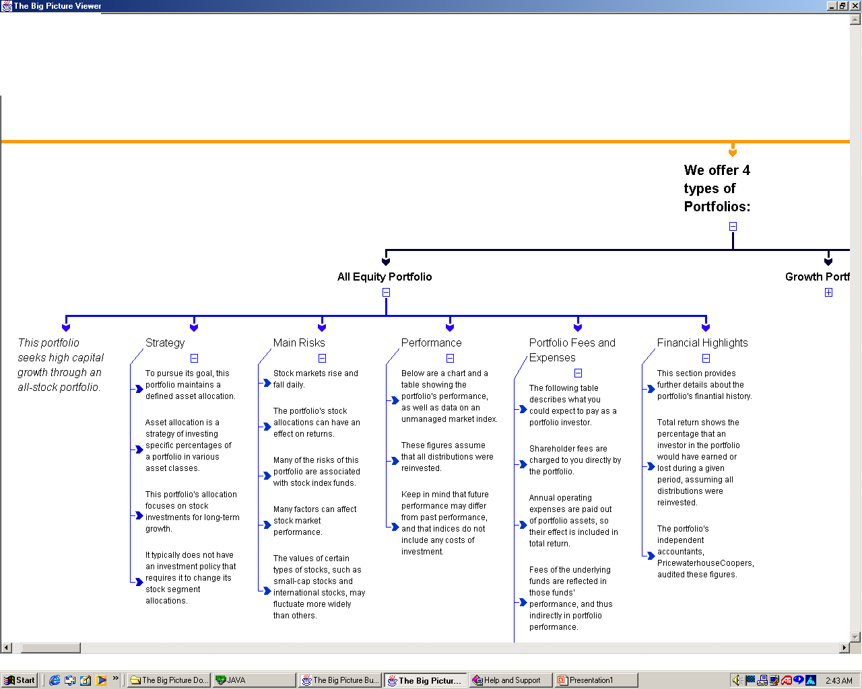

Slide 7
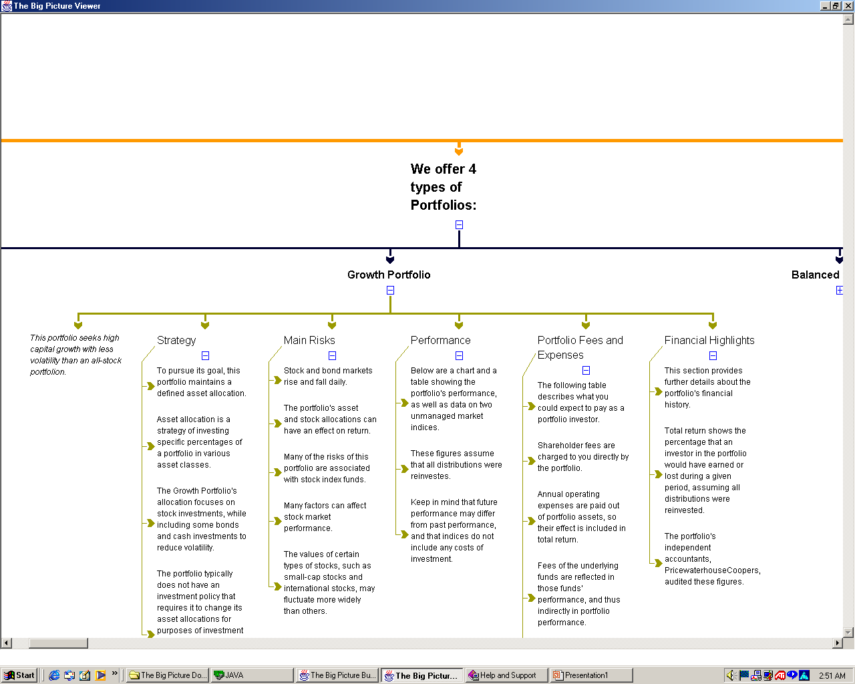

Slide 9
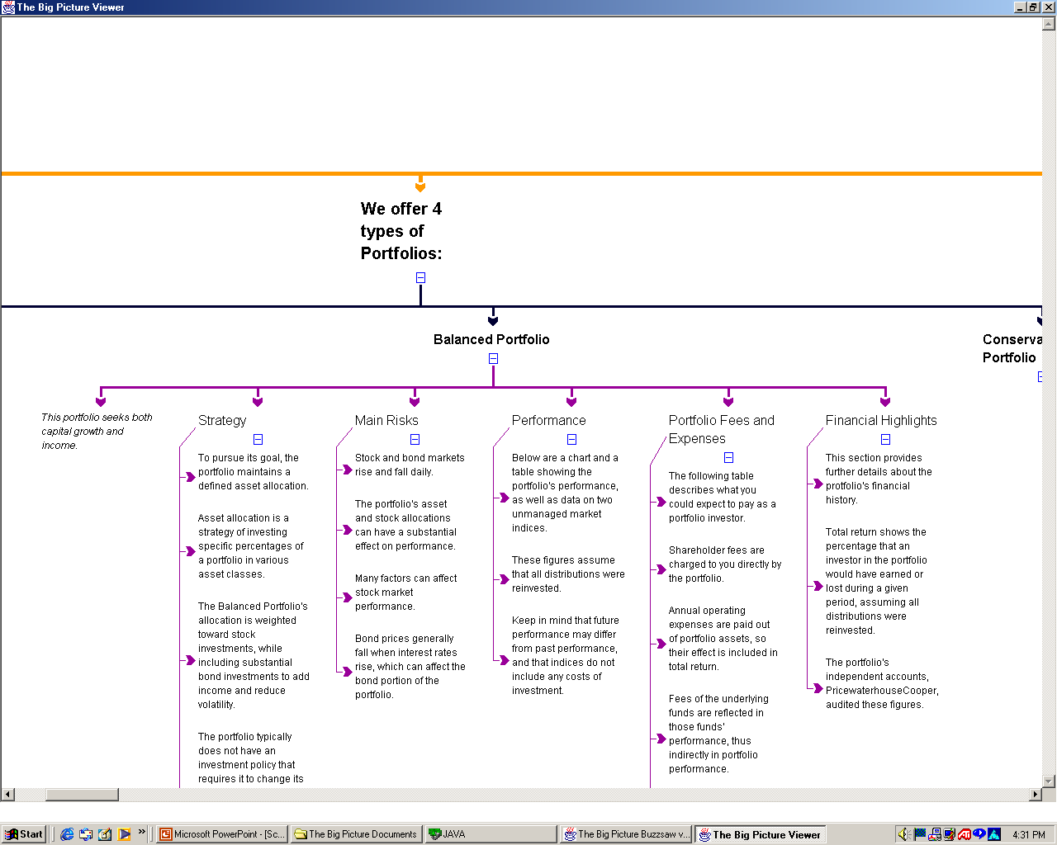

Slide 10
Application # 2:
Companies providing information about their products:
E.g. JVC, Inc.

Slide 11


Slide 12
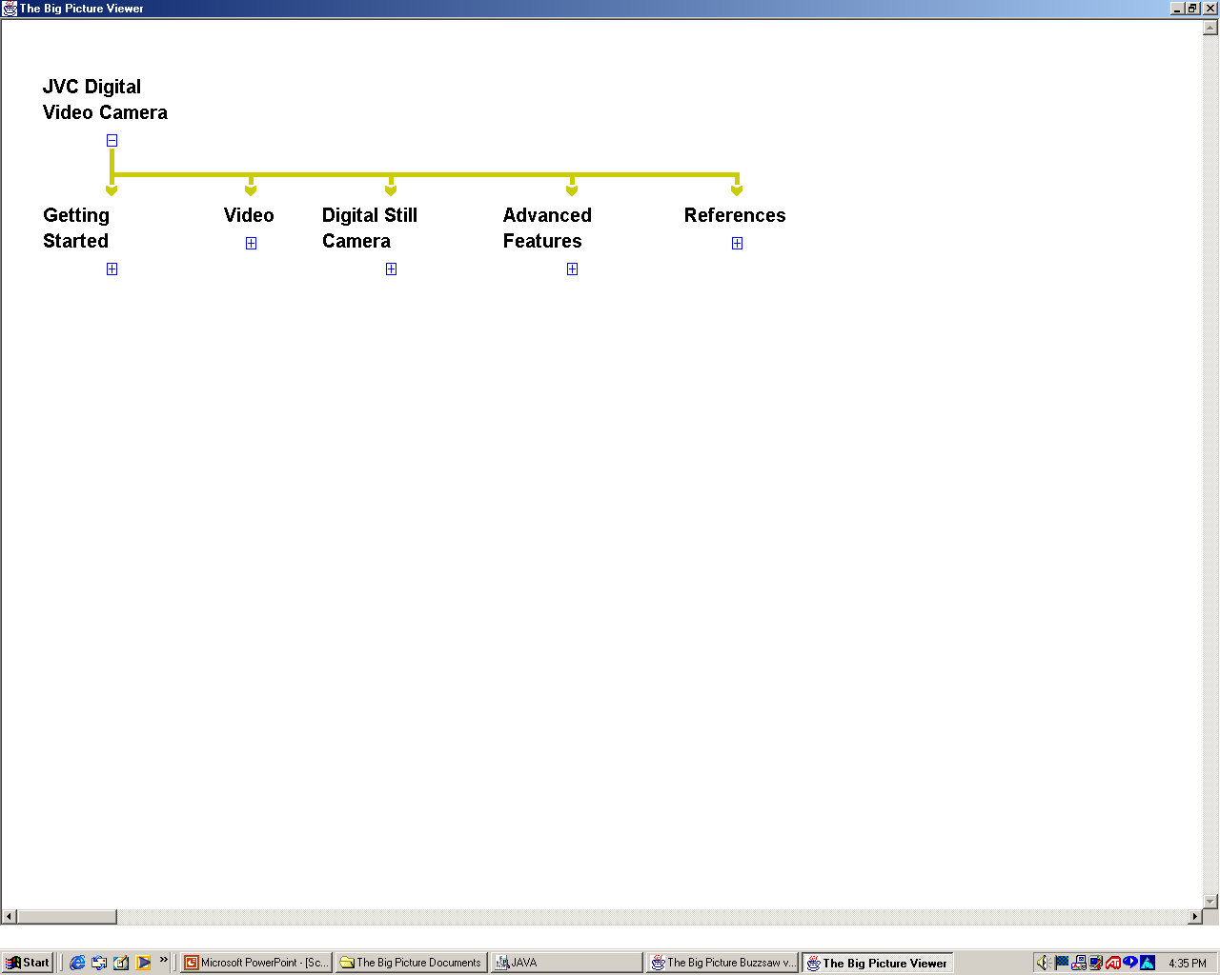

Slide 13
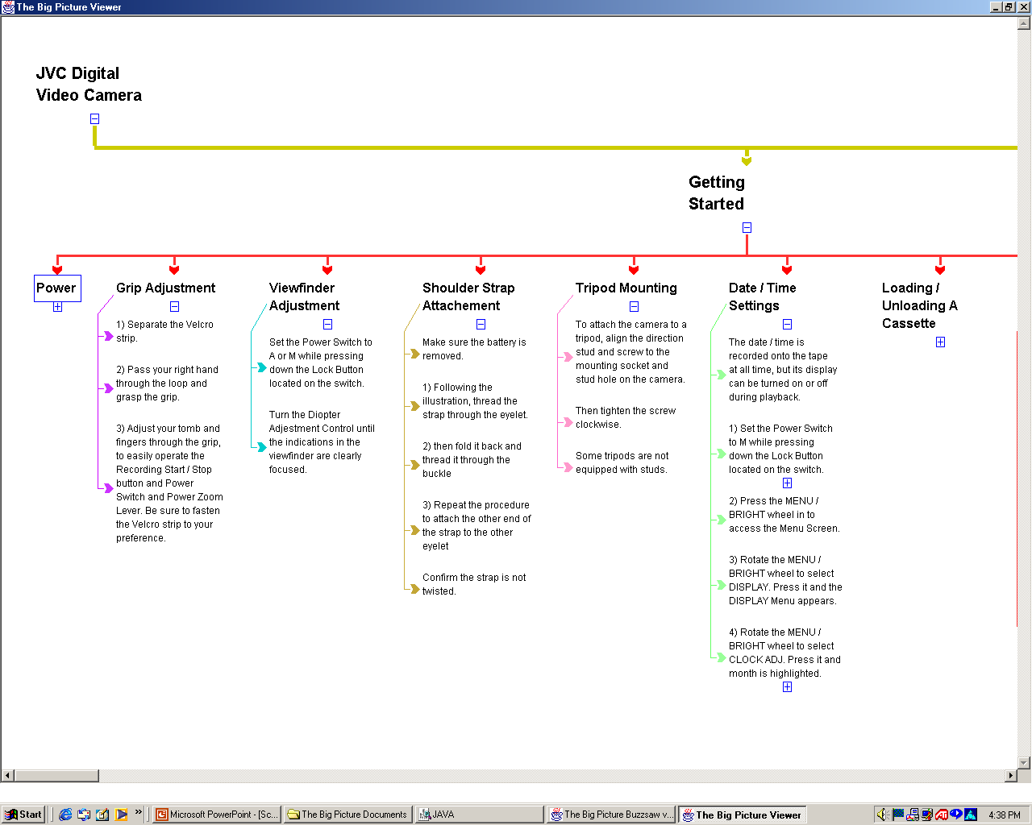

Slide 14
Application # 3:
Publishing companies:
E.g. McGraw-Hill’s anatomy book

Slide 15


Slide 16
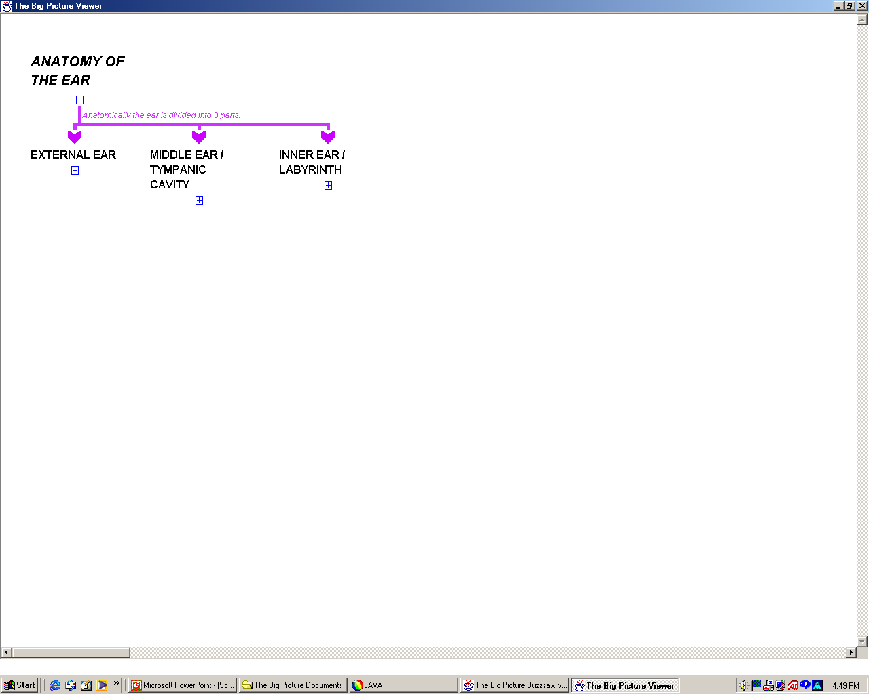

Slide 17
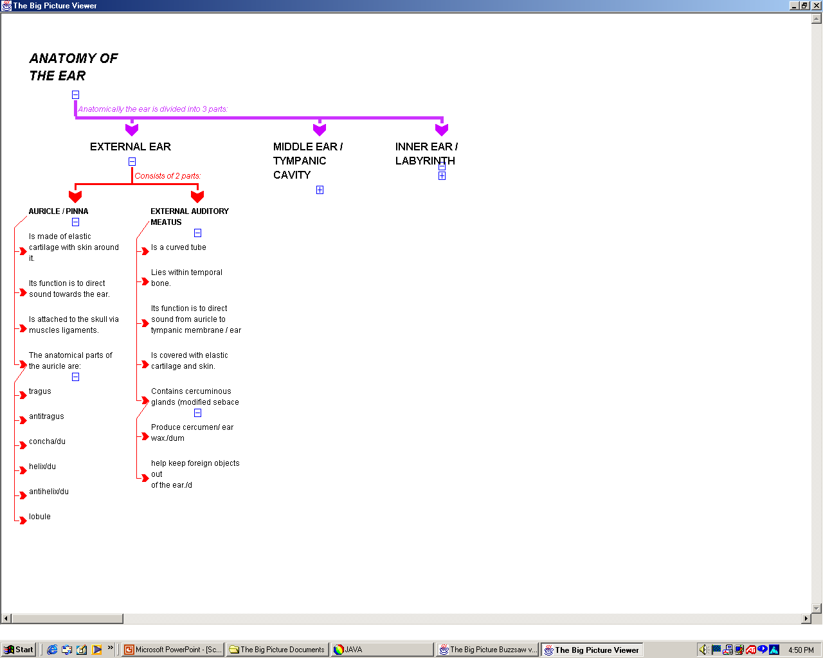

Slide 19
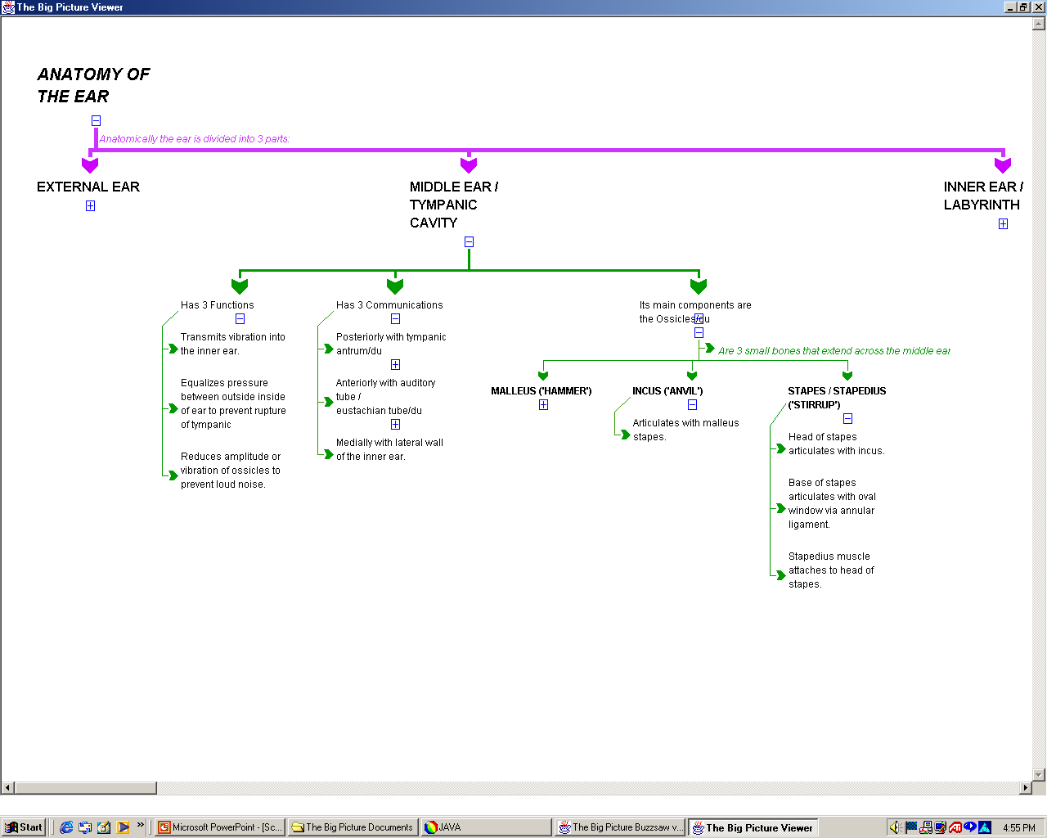

Slide 21
